Slide 1
Programs and services catalog
State Reentry Council Collaborative
November 12, 2024

Slide 2
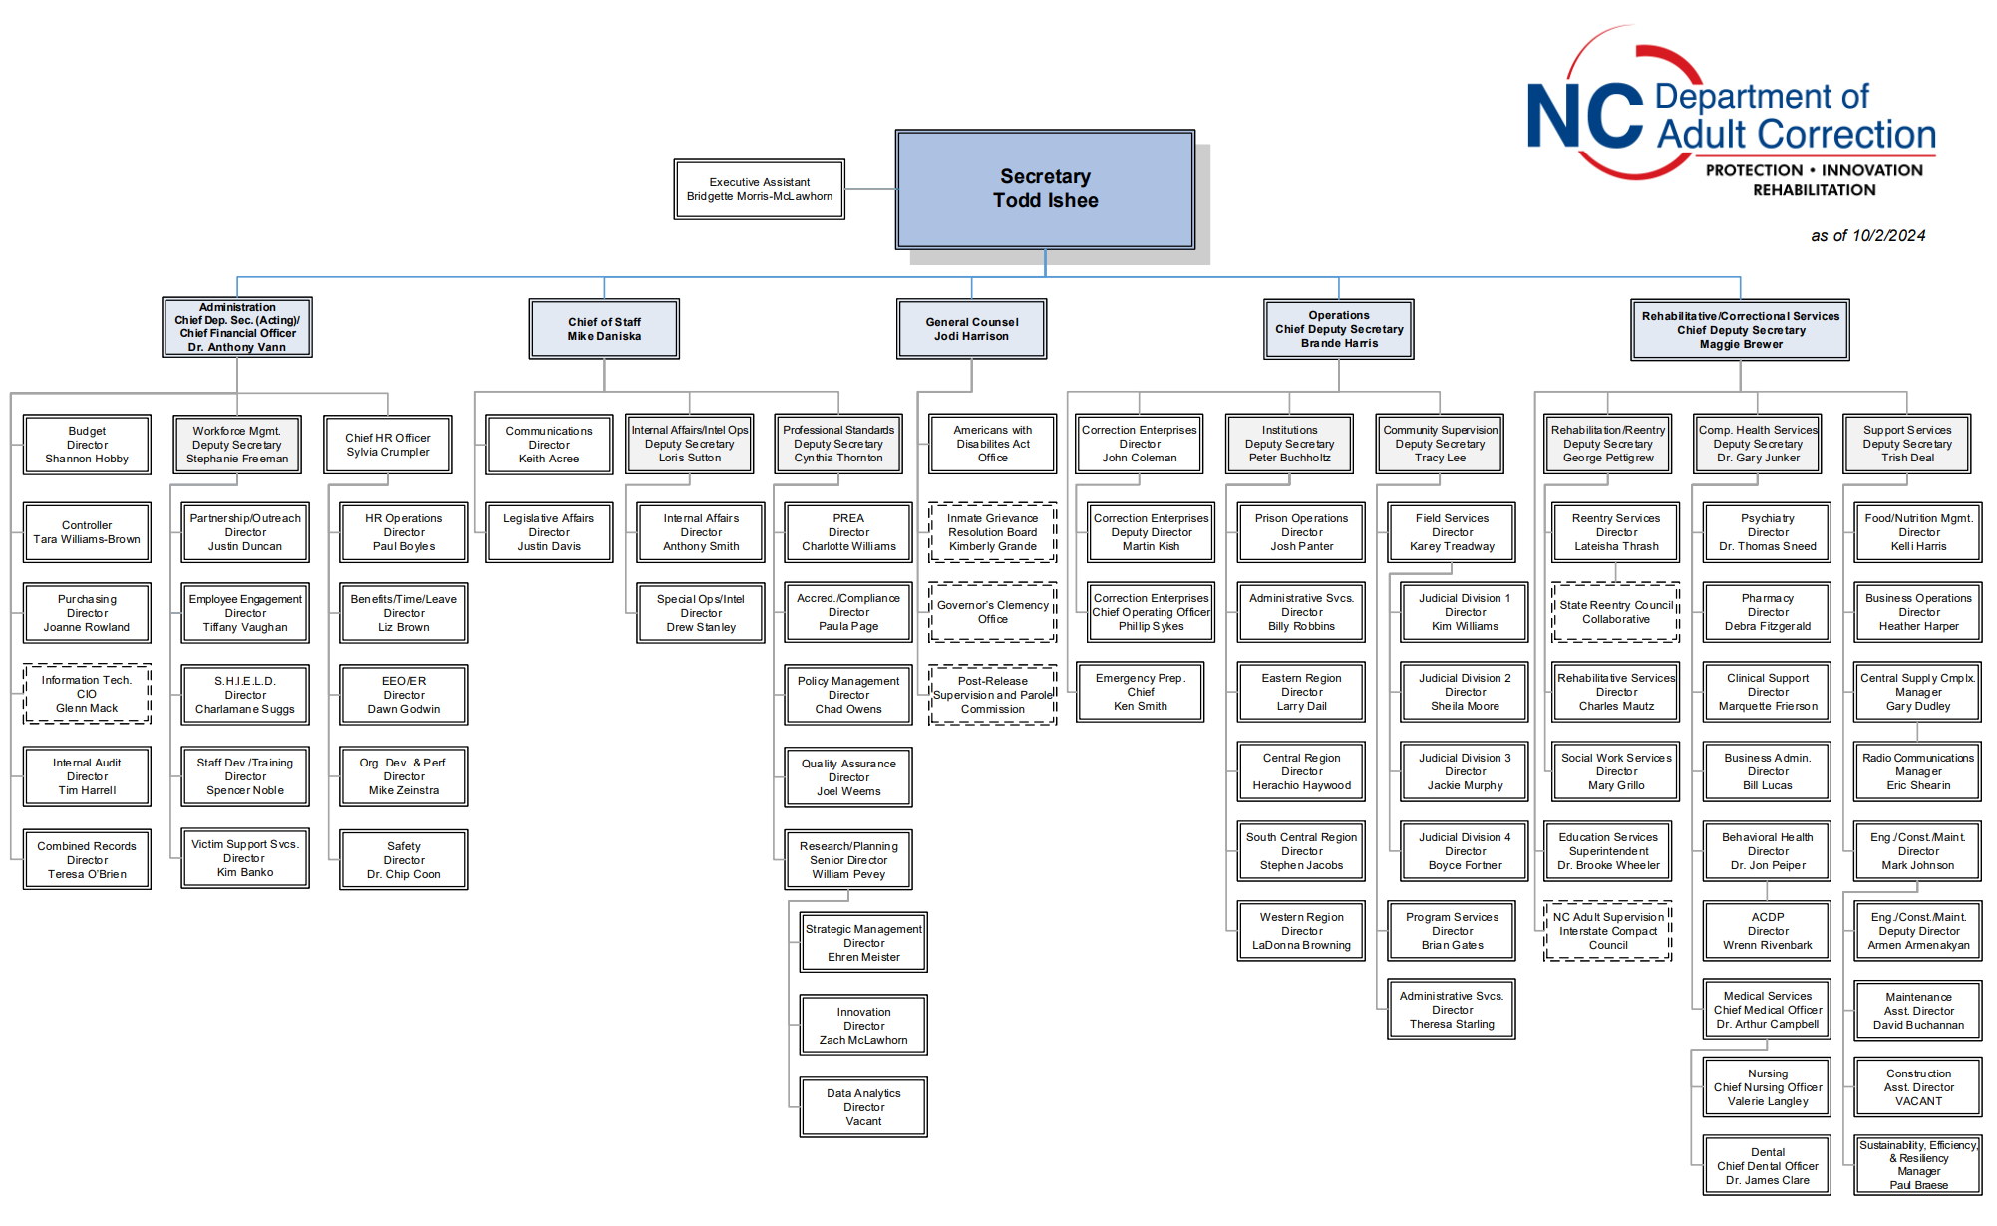
Background and Development

Slide 3
Meeting Stakeholder Needs
Ease of Access
Enhanced Transparency
Facilitating Planning, Communication
Family Support
Reentry Preparation

Slide 4
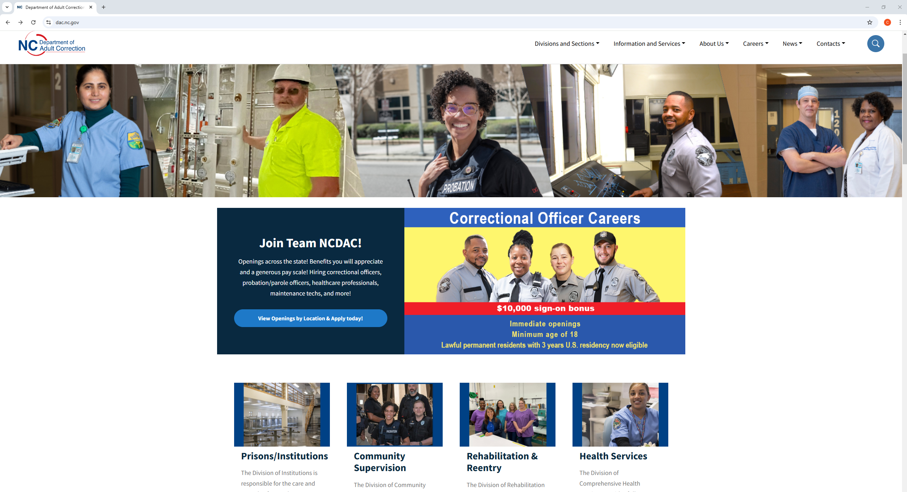
Access

Slide 5
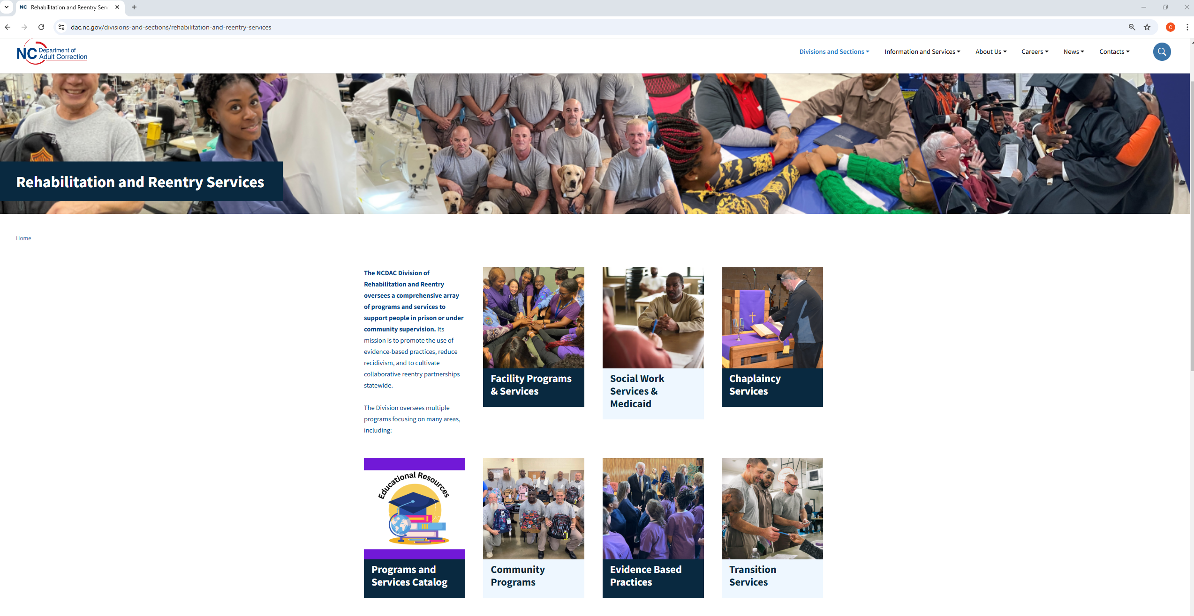
Access

Slide 6
Navigation

Slide 7
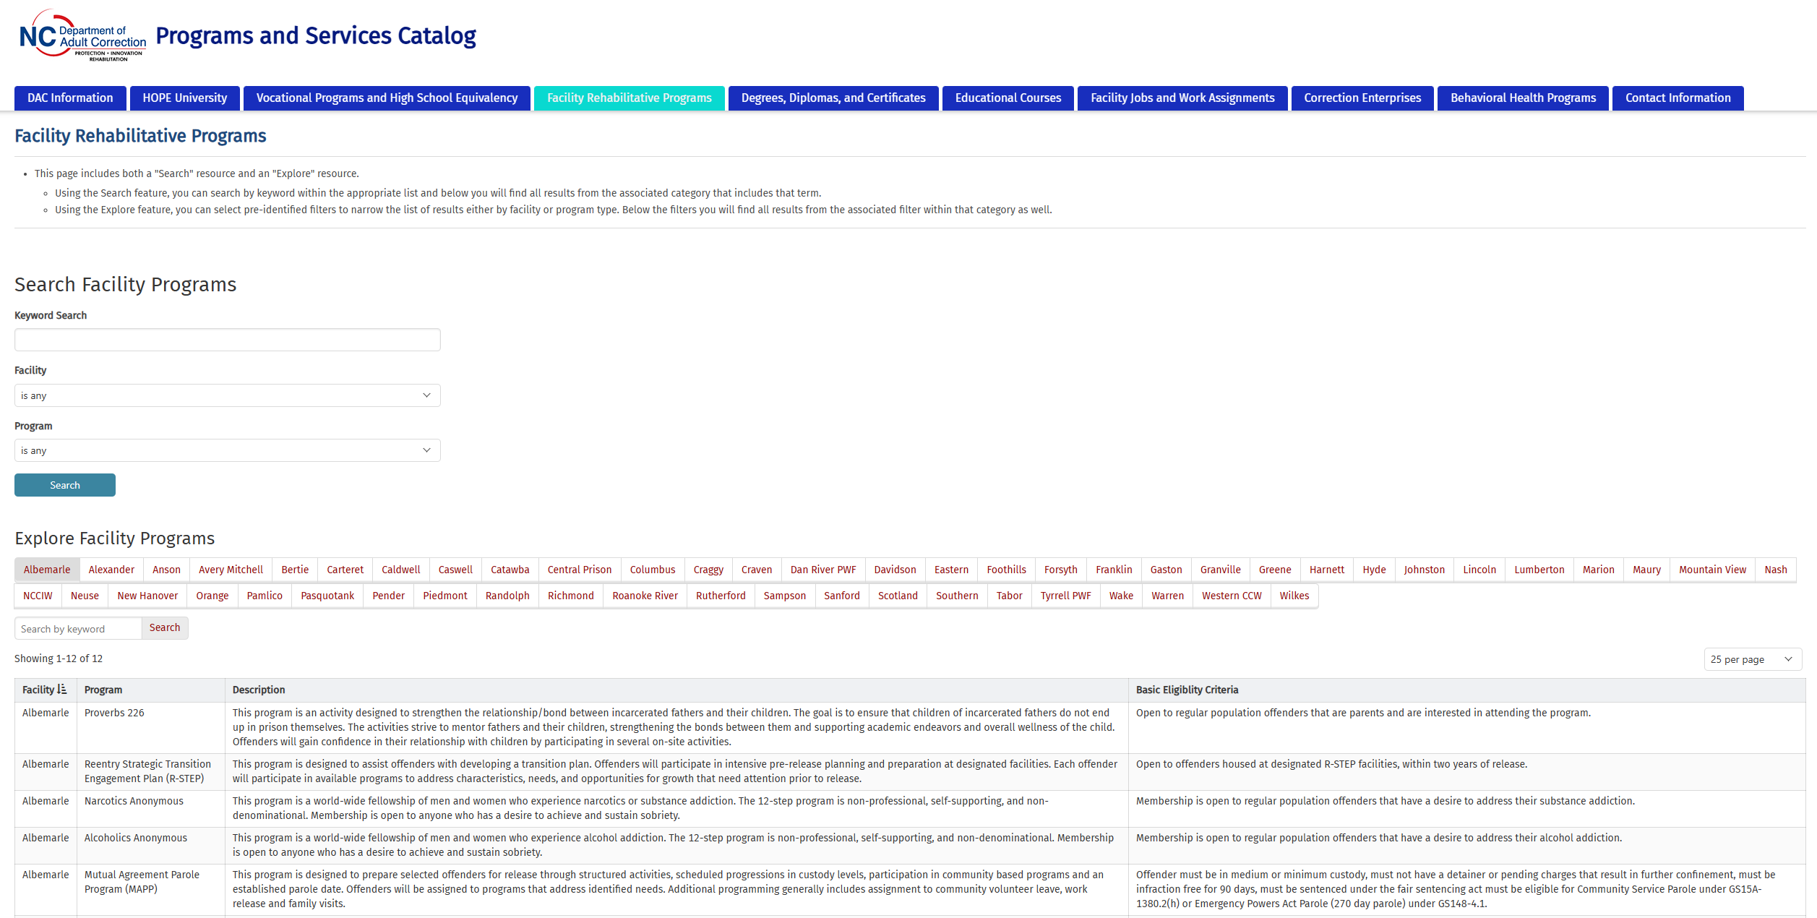
Navigation

Slide 8
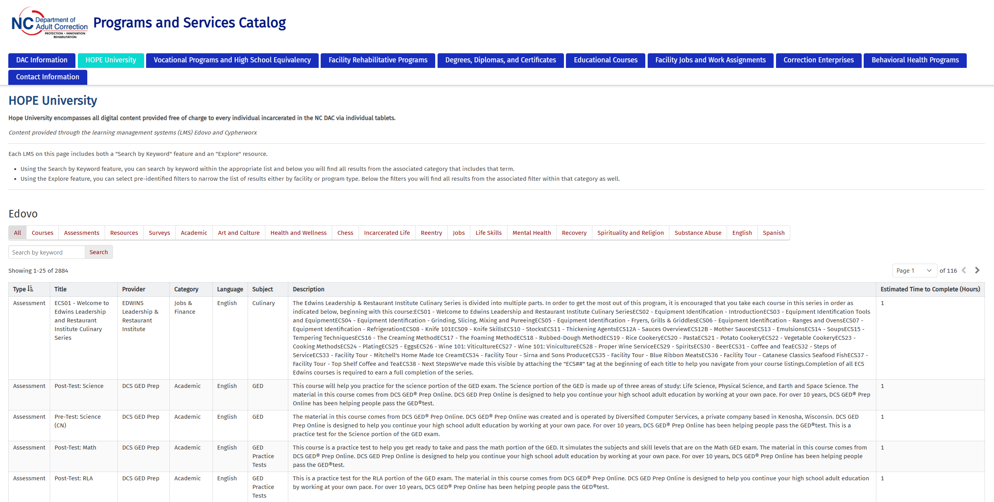
HOPE University

Slide 9
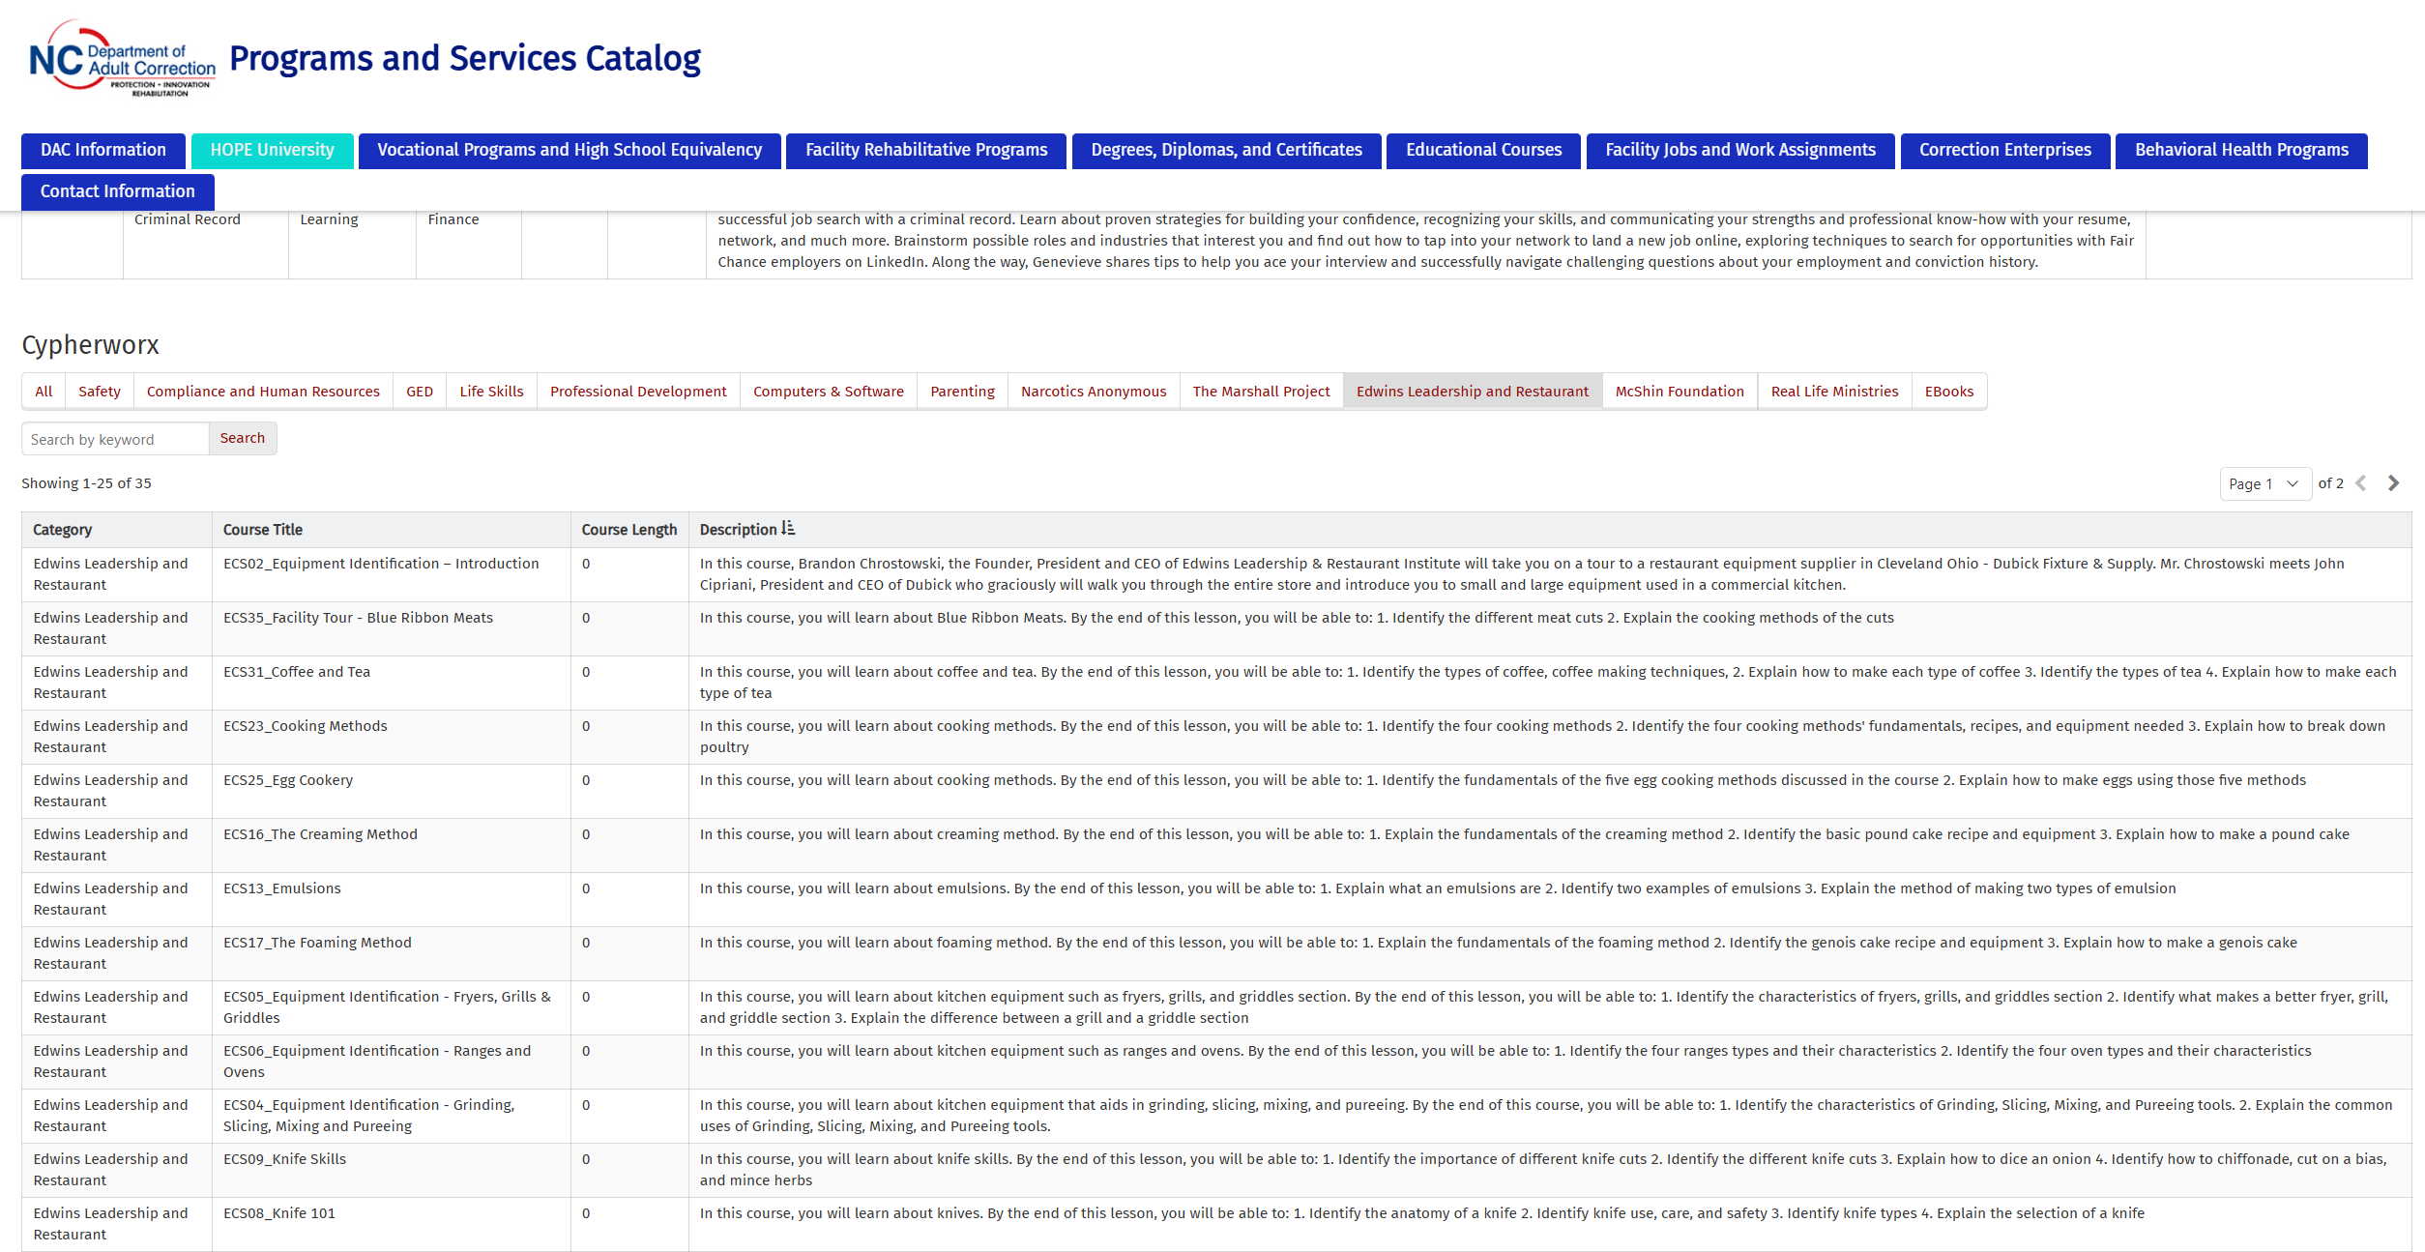
HOPE University

Slide 10
Demonstration
Let's hope this works!

Slide 11
Contact Information

Slide 12
Contact Information
Charles Mautz (charles.mautz@dac.nc.gov)
Gregory Swink (gregory.swink@dac.nc.gov)
Dr. Brooke Wheeler (brooke.wheeler@dac.nc.gov)

