Slide 1
Building Bridges to Employment: Understanding Federal Bonding and WOTC
Donna Farrar, Federal Bonding Coordinator
Annie Gomez, WOTC Program Coordinator

Slide 2
Federal Bonding Program

Slide 3
Federal Bonding Program
Provides fidelity bonds to employers, giving them access to job seekers and open doors of opportunity
Eligible Individuals Include:
Justice-involved citizens
Individuals in recovery from substance use disorders
Welfare recipients
Individuals with poor credit records
Economically disadvantaged youth and adults who lack work histories
Individuals dishonorably discharged from the military
$5,000 in coverage (Up to $25,000)
6 Months of Coverage
No application or forms to complete
No Deductible if employee dishonesty occurs

Slide 4
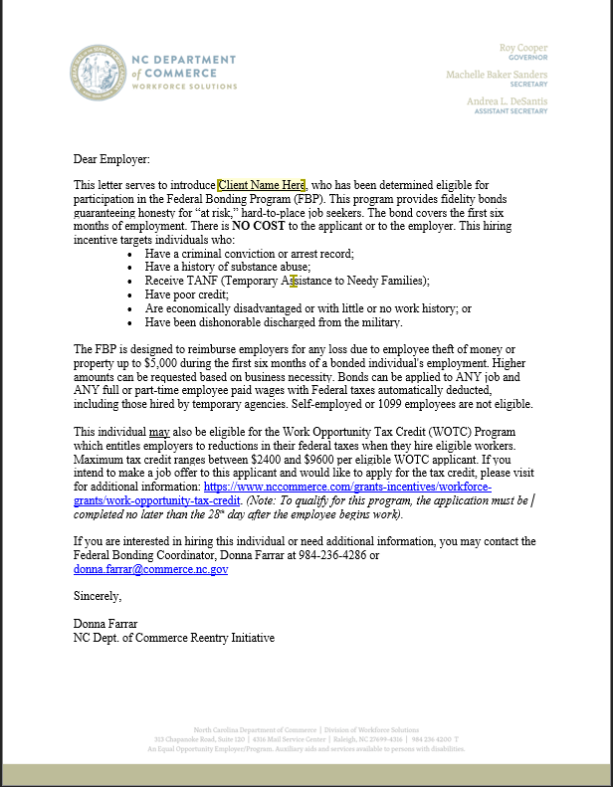
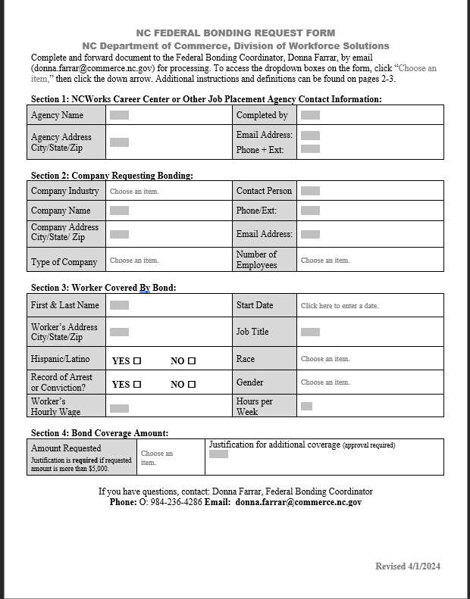
Federal Bonding Cont’d
Federal Bonding Eligibility Letter
Federal Bonding Request Form

Slide 5
Resources
Federal Bonding Information
Visit https://bonds4jobs.com/

Slide 6
CONTACT INFORMATION
DONNA FARRAR
DONNA.FARRAR@COMMERCE.NC.GOV
984-236-4286

Slide 7
Annie Gomez Work Opportunity Tax Credit Program Coordinator
WORK OPPORTUNITY TAX CREDIT PROGRAM IN NORTH CAROLINA

Slide 8
What is Work Opportunity Tax Credit?
WOTC is a federally funded tax credit program designed to encourage businesses to hire and retain individuals with significant barriers to employment.
The North Carolina Division of Workforce Solutions (DWS), part of the N.C. Department of Commerce, administers the WOTC program and determines eligibility for the Tax Credit.

Slide 9
About WOTC
Federal incentive program
Congressional renewal through December 31, 2025
(Consolidated Appropriations Act, 2021)
WOTC can be combined with:
State tax credits
Federal bonding
On-the-job training (OJT)
Registered apprenticeships

Slide 10
Who is Eligible?
Ex-felon
Temporary Assistance to Needy Families (TANF) recipient
Supplemental Nutritional Assistance Program (SNAP) recipient
Designated community resident
Empowerment Zone/Rural Renewal Community
Vocational Rehabilitation
Ticket-to-Work participant
Supplemental Security Income recipient
Long-term Unemployment individual
Unemployed Veteran 6 months
Unemployed Veteran 4 weeks
Disabled Veteran
Veteran SNAP recipient
SCD Unemployed Veteran

Slide 11
Submission Requirements
Submit within 28 calendar days from the start date of new employee.
Documentation supporting eligibility may be required, but it can be electronically submitted or mailed later if necessary.
- SNAP, TANF & Voc Rehab documentation is not required unless the qualifications were met in a state other than NC.
There are no restrictions as to the number of qualified hires for which an employer can take a credit on, whether 1, 10 or 100.

Slide 12
Submission Methods
E-file by creating an account with NCWorks WOTC Account Request :
https://www.ncworkswotc.com/AccountRequest.aspx
E-file set up involves contact person requesting an account, this request includes business name and FEIN number, the person requesting the account chooses his or her email address, user ID and a password.

Slide 13
Questions about WOTC?
Email: ncworkswotc@commerce.nc.gov
or
https://www.commerce.nc.gov/grants-incentives/workforce-grants/work-opportunity-tax-credit

Slide 14
For more information on WOTC
Annie T. Gomez
WOTC Program Coordinator
North Carolina Department of Commerce Division of Workforce Solutions
4316 Mail Service Center Raleigh, NC 27699-4316
Phone: (984) 236 4180
Mobile: (984) 960 8926
annie.gomez@commerce.nc.gov

Slide 15
Spanish Language
https://www.dol.gov/agencies/eta/wotc/how-to-file
Note: Spanish Language form is used with the new hire to capture information accurately, but the application must be submitted in English.
Watch this informative video: NC Work Opportunity Tax Credit Guide for Employers

Slide 16
Questions???
Notes:
A slide to showcase the agency’s website

Slide 17
Thank You
Notes:
A slide to showcase the agency’s website

